Slide 1
Project NLP Challange (Group 1)
Ben, Armando, Quincy and Bianca

Slide 2
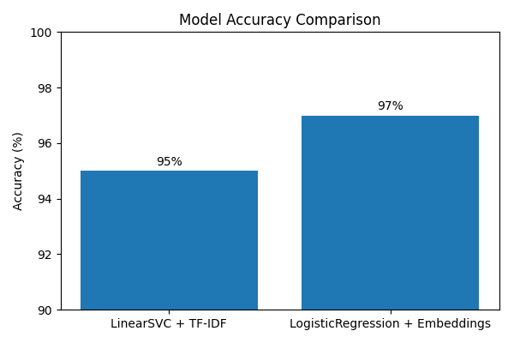
Executive summary
Final results:
LinearSVC+TF IDF: accuracy is 95%
LogisticRegression + embeddings: accuracy is 97%
Model used:
  LinearSVC
  LogisticRegression + embedding
Alternative models tested:
  Logistic Regression
  Naive Bayes
  SVM
  Neural Networks
Other important methodology or considerations:
We used consistent preprocessing for all models, we kept the same train and validation split for every model, so the evaluation was consistent.The Neural Network performed slightly better because embeddings capture semantics, while IDF-TF only counts frequency.

Slide 3
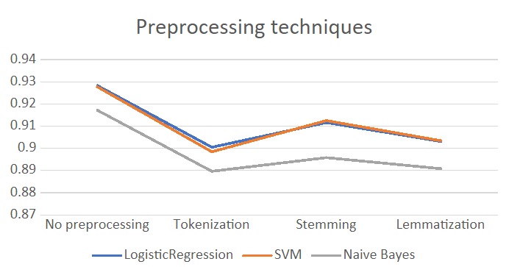
Methods (preprocessing)
Different preprocessing techniques were tested:
  tokenization -> then removal of stop words
  stemming -> then removal of stop words
  lemmatization -> then removal of stop words
  no preprocessing
The dataset is already lowercase.
The best results are achieved using the dataset with no preprocessing and LogisticRegression (train/test split = 90%/10%). Accuracy: 92.82%.

Slide 4
Methods (embedding)
We used OpenAI embeddings.
We performed no preprocessing of the data before running the embeddings functions.
We tested the classifiers: Logistic Regression, Random Forest.
The highest accuracy was for embeddings with Logistic Regression. Accuracy: 97.30%.

Slide 5
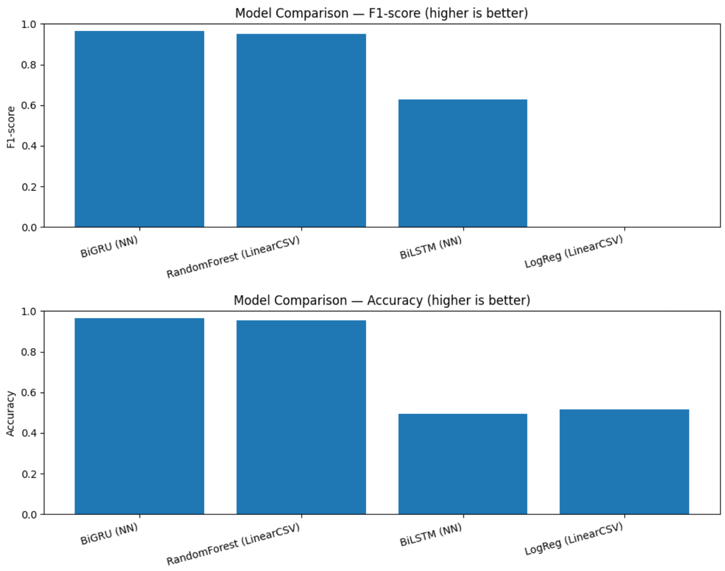
Models Overview
80/20 Split

Slide 6
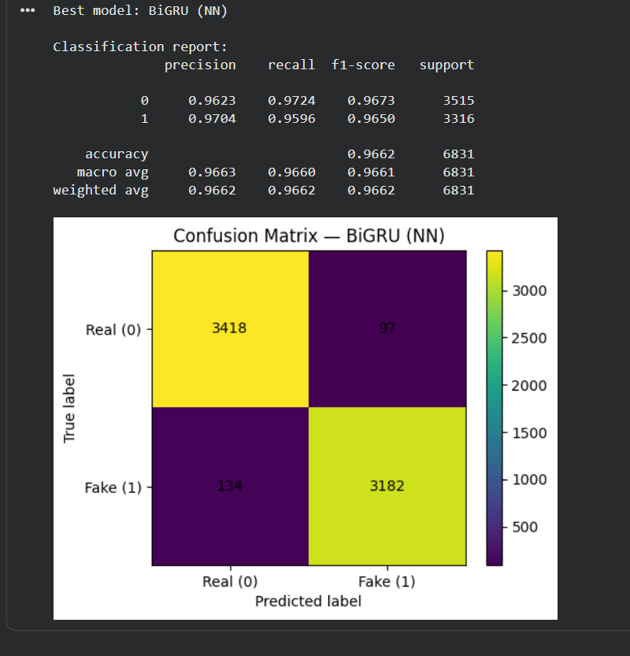
Best Model
Real = 1
Fake = 0
FP = 97
FN = 134

Slide 7
Takeaways
Recap
Best: OpenAI Embeddings + LogisticRegression Acc/ 97.30% Next: BiLSTM (Model 5) — Acc/F1 97.07%, Val loss 0.1194 Baseline: TF-IDF + LinearSVC (Model 1) — Acc 95%, F1 0.96 TF-IDF RandomForest — Acc 95%, F1 0.95
Challenges
Technical conflicts when running model cross-testing. Understanding what changes could actually improve the models to match expectations. Tooling friction: kernel resets and file path issues when saving models. Finding alternative datasets for python versions. Workflow.
Key Learnings
Understanding your model for the relationship to solve the problem matches your expectations. Simplicity of the models is better than overcomplicating for negligible improvement. Bidirectional RNNs capture context better than Embedding + Pool (Model 4 Acc 0.9463)

Slide 8
Instructions
All team members must participate (either split the slides, or discuss the part that you did for each slide)
10 minutes for presentation (HARD limit) + 3 minutes for questions
Tip: Rehearse the presentation at least once
Submit: code + ppt + predictions csv on a github repo
Deadline: Friday 16:30pm. Presentations will start around that time so we have a 30-min buffer to account for technical issues
Each student must submit their own answer to the Ironhack portal
  Group members may submit the same repo

